Slide 1
Data Link Layer Part III: Medium Access Control

Slide 2
Multiple Access Links and Protocols
Up to now we assumed any given two hosts are connected point to point via a wire-like link
We computed efficiency for error and congestion control protocols such as stop and wait
datagram
link layer protocol
rcving
node
sending
node
frame
frame
adapter
adapter

Slide 3
Shared Communication
Not all connections are point to point
broadcast (shared wire or medium)
old-fashioned Ethernet
802.11 wireless LAN
shared RF
(e.g., 802.11 WiFi)
shared wire (e.g.,
cabled Ethernet)

Slide 4
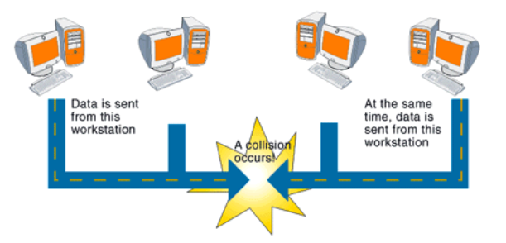
Shared Communication
Single shared broadcast channel
Every transmission can be received by all nodes
two or more simultaneous transmissions by nodes lead to corrupted signals
Collision / interference

Slide 5
Medium Access Control
A node needs to access the shared channel to be able to transmit the data link layer frame to the next node
We need a method to give access to the nodes:
Each node is able to use a (fixed or variable) fraction of the channel bandwidth
Shared medium behaves somehow like a point to point link
A very well known version of this problem is bus arbitration in computer architecture

Slide 6
Overall Picture: Data Link Layer and Medium Access Control
Data Link Layer: Creating a reliable link requires:
This transmission should be reliable as if nodes are connected by a direct link➔ Data Link Control / Logical Link Control
Network nodes should be able to transmit over the physical channel➔ Medium Access Control
…
Network
DLC/LLC
MAC
Physical
DLL
DLL: Data Link Layer
DLC/LLC: Data Link Control
-Logical Link Control
MAC: Medium Access Control

Slide 7
Medium Access Control Methods
Collision-free access
Static Channel Allocation
TDM, FDM, WDM
Demand Assignment Protocols
Polling, token, bit map
Deterministic Collision-resolution
Access with collision
Dynamic Channel Allocation
ALOHA, CSMA

Slide 8
Static channel allocation
Static and predetermined allocation of channel access: independent of user activity
Only the user for which the channel is allocated can transmit
TDM, FDM, WDM

Slide 9
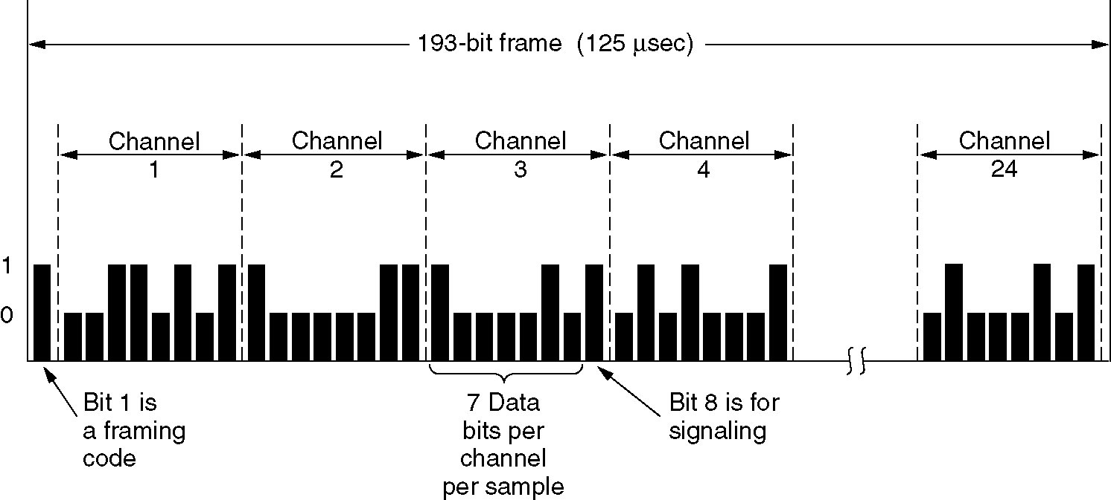
Static Channel Allocation: Time Division Multiplexing
The T1 carrier (1.544 Mbps).
Digital phone

Slide 10
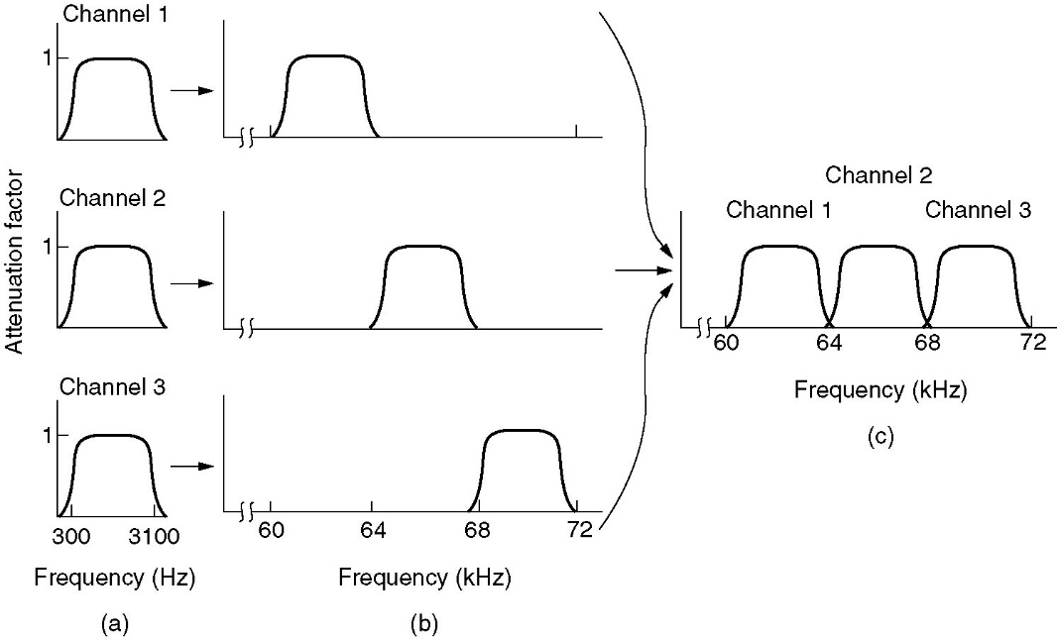
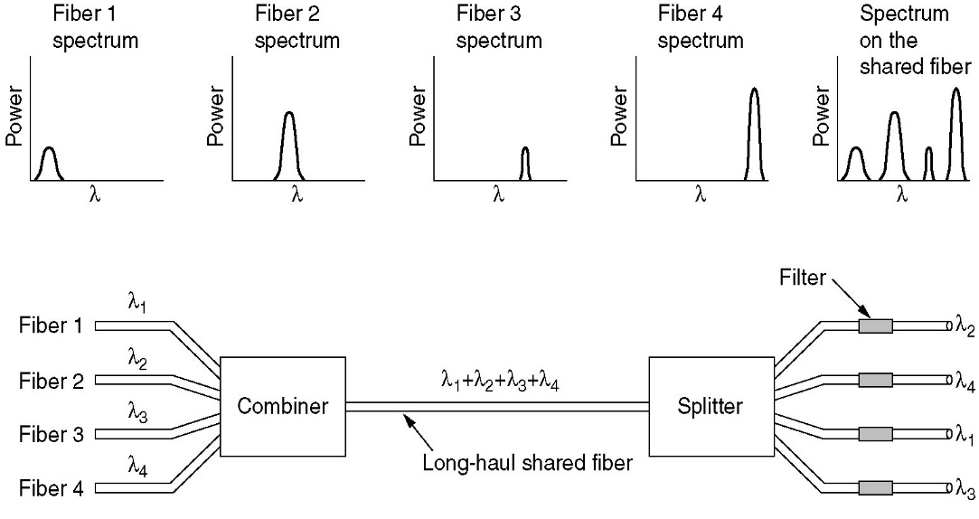
Static Channel Allocation: Frequency/Wave Division Multiplexing
WDM
FDM
Example: Cable TV

Slide 11
Demand Assignment Protocols
Allocate channel capacity to hosts on a demand basis (i.e., only to active users)
Requires methods for measuring/collecting the demand for the channel

Slide 12
Demand Assignment Protocols
Two modes of operation:
Reservation/Arbitration: for all nodes, always takes a deterministic amount of time
Data transmission: Duration depends on the availability of data
Reservation/Arbitration:
Each station declares if it has data to send
Exclusive to each node, each node has a guarantee to make the declaration
Different ideas for declaration:
Nodes can do it on their own
A master node can ask each node and they can answer

Slide 13
Demand Assignment Protocols
Reservation and data transmission can be two separate time periods or can be interleaved for each node
Separate reservation and data transmission
1
TD1
2
TD2
3
4
5
TD5
Interleaved
What does the efficiency depend on?

Slide 14
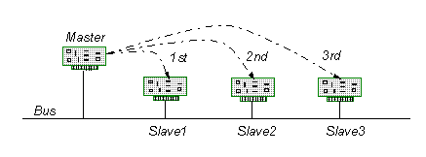
Demand Assignment Protocols: Polling
A central controller (master) asks each host (slave) if they will transmit
Allocates channel capacity to those who need it
Master can ask separate or interleaved

Slide 15
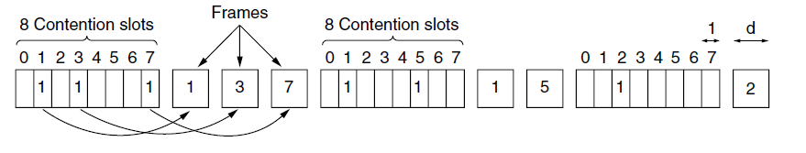
Demand Assignment Protocols: Bit-Map Protocol
Consecutive reservation and data transmission periods
N stations each with unique address from 0 to N-1
Each reservation period consists of exactly N slots of 1 bit each
Station j may announce that it has a frame to send (only if so) by sending 1 bit in j^{th} slot
After all N slots have passed by, each station knows which station will transmit
They begin transmitting in the numerical order as agreed before

Slide 16
Demand Assignment Protocols: Flexible TDM
1
2
3
4
5
6
TDM
1
2
3
4
5
6
Flexible TDM
Each node has a short allocated slot.
Declares that it has a frame to transmit in this slot and goes on transmitting
Used in:
High-speed Automotive
FlexRay Dynamic Segment

Slide 17
Efficiency
Static allocation: A station wastes its allocated resource for data transmission if there is nothing to send
Demand assignment: A station wastes its allocated resource for reservation if there is nothing to send ➔ less loss compared to static
Both methods have
NO COLLISION
High efficiency if every station always has something to send
Low efficiency if there are a lot of stations and these stations are mostly idle

Slide 18
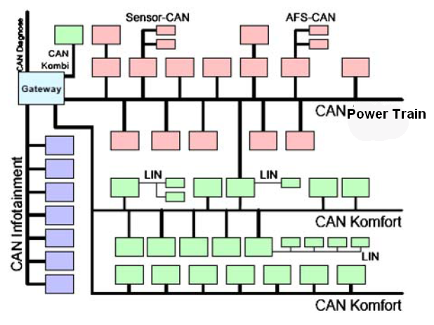
Deterministic Collision Resolution
There is collision
The winner of the collision is deterministic
Deterministic Collision resolution➔ Real-time systems require deterministic response
Real-time Embedded Systems: Automotive, automation, factory control, avionics and medical equipment.
VW Passat CAN Network
Example:
Controller Area Network (CAN) Bus

Slide 19
CAN standard (MAC protocol): Transmitting data
A CAN frame is labeled by an identifier (ID), transmitted within the frame
ID numerical value determines the frame priority.
Smaller ID➔ Higher priority

Slide 20
CAN standard (MAC protocol): Transmitting data
CAN physical layer:
Implements the logical “and” operator
if at least one node is transmitting the “0” bit level on the bus, then the bus is in that state regardless if other nodes have transmitted the “1” bit level.
“0” is the dominant bit
“1” is the recessive bit.

Slide 21
CAN standard (MAC protocol): Transmitting data: Example
Any CAN node may start a transmission when the bus is idle.
In case of simultaneous transmissions, the highest priority frame will be sent despite the contention with lower priority frames.
Node 2 detects that a frame with a higher priority than its own is being transmitted when it monitors a level 0 (i.e., dominant level) on the bus while it has sent a bit with a level 1 (i.e., recessive level).
Afterwards, Node 2 immediately stops transmitting.

Slide 22
CAN standard (MAC protocol): Transmitting data
Sending node monitors the bus while transmitting.
The signal must be able to propagate to the most remote node and return back before the bit value is decided.
This requires the bit time to be at least twice as long as the propagation delay
Limits the data rate

Slide 23
Dynamic Channel Access: Contention-based channel access
Solution: Contention-based channel access (random access)
Multiple users share a common channel
They contend (try to transmit) for the channel
There are collisions and nobody knows who will transmit next!

Slide 24
Node Capability
MUST:
Collision Detection after transmitting
OPTIONAL:
Carrier Sense: Listen channel before transmitting to detect if the channel is busy or not.
Ancestor Ideas:
ALOHA and Slotted-ALOHA
These ideas evolve into the MAC protocols that are used everywhere such as IEEE 802.3 (Ethernet)

Slide 25
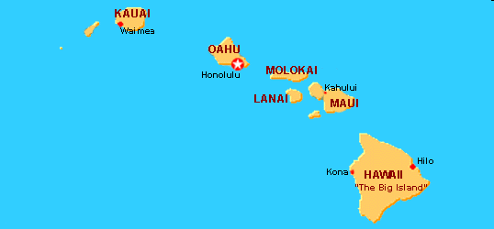
ALOHA Protocol
In the seventies, the ALOHA system was proposed by Norman Abramson as an effective solution to provide for wireless access to computer systems.
The ALOHA-net at the University of Hawaii employed fixed transmitters at islands located at ranges of several tens of kilometers.
SIMPLE IDEA: Terminals can transmit their data regardless of the activity of other terminals.

Slide 26
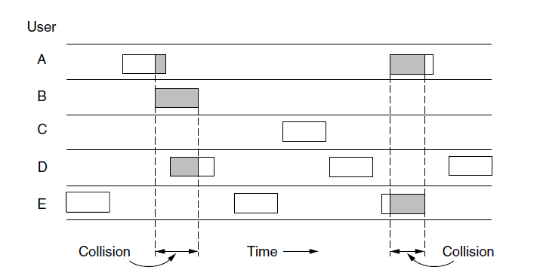
Pure ALOHA Model
Operation:
Fixed length frames: time to transmit a frame=t
Continuous time: Each station transmits whenever it wants (i.e., whenever a frame is generated)
Stations can detect collisions
When collision, sender waits for a random amount of time and sends it again. (Why random??)

Slide 27
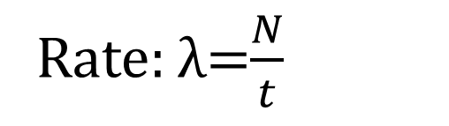
Pure ALOHA Model
Frame time: t
Mean frame generation rate = N frames per frame time (N/t)
(0<N<1)➔ the network is not overloaded
In addition to new frames, stations also generate retransmissions of frames that previously collided
Rate: λ=$\frac{N}{t}$

Slide 28
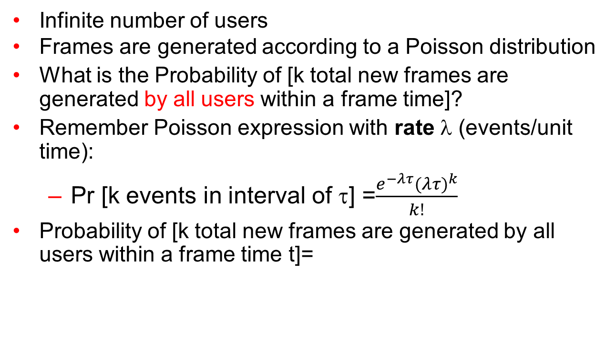
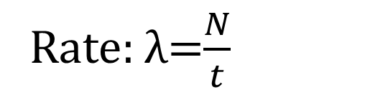
Pure ALOHA Model
Infinite number of users
Frames are generated according to a Poisson distribution
What is the Probability of [k total new frames are generated by all users within a frame time]?
Remember Poisson expression with rate λ (events/unit time):
Pr [k events in interval of τ] =$\frac{e^{−λτ}{(λτ)}^{k}}{k!}$
Probability of [k total new frames are generated by all users within a frame time t]=
Rate: λ=$\frac{N}{t}$

Slide 29
Pure ALOHA Model
Total frame generation (new + retransmitted) is also according to a Poisson distribution
Mean rate of G frames per frame time (at low load: G~N, high load: G>N, in general: G≥N)
Probability of k transmission attempts per frame time (for retransmit when collision + new frames)

Slide 30
Pure ALOHA: Throughput
Given:
G: offered load
P₀: Probability of a successful transmission
Throughput per frame time: S=GP₀
How to find P₀?

Slide 31
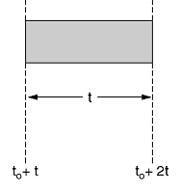
Pure ALOHA: Throughput
Consider a test frame whose transmission starts at time = t₀+t
Vulnerable period for the shaded frame = time period where if another frame transmission starts shaded frame will have collision
For a frame to be successfully transmitted, there should be no other frame generated during a vulnerable period
Frame duration is t
Transmission finish at 2t+t₀
Background traffic: Infinite number of stations generate frames with Poisson distribution.
Test frame is one additional frame that we observe

Slide 32
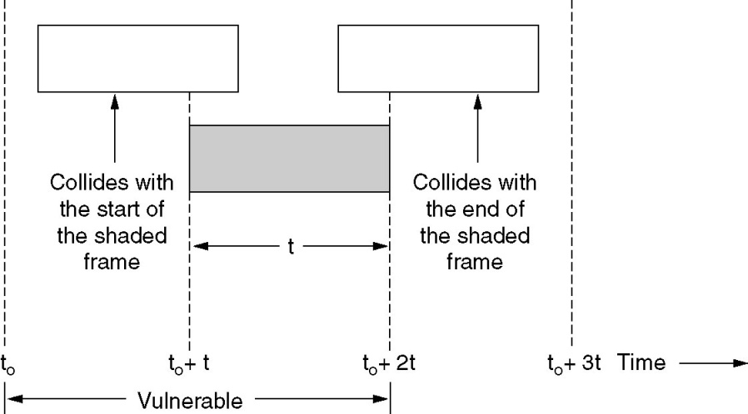
Pure ALOHA: Throughput
What is the vulnerable period for the shaded frame?
There are infinite users
Assume:
We observe one user that wants to transmit (test frame: shaded frame)
If the remaining infinite users do not transmit in the vulnerable period, then the shaded frame can be transmitted successfully
Vulnerable period for the shaded frame: two frame times

Slide 33
Pure ALOHA: Efficiency
Probability of successful transmission of the shaded test frame:
Pr [no frames in two frame times] = P₀
Mean rate of G frames per frame time
Throughput:

Slide 34
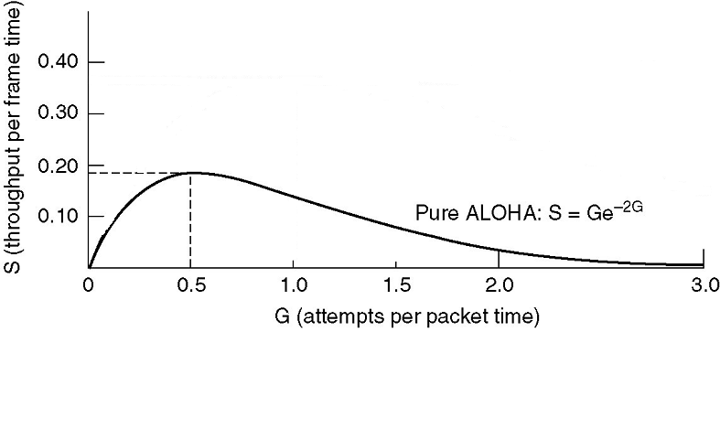
Pure ALOHA: Throughput
The maximum throughput:
G=0.5 (Why?)
S=1/2e which is around 0.184
The maximum channel utilization with Pure ALOHA is around 18%
How can we improve this?
Observe: the throughput is related to the length of the vulnerable period

Slide 35
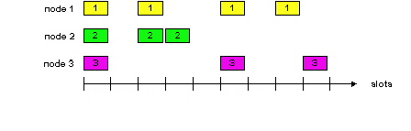
Slotted ALOHA
Idea:
Divide up time into intervals (slots), each interval corresponding to one frame
All stations are synchronized
Restrict the transmission times: Each station can only start transmitting at the beginning of a slot
If collision occurs, sender retransmits the packet in a future slot until successful

Slide 36
Slotted ALOHA Model
Same load assumptions and test frame model as pure ALOHA
Mean rate of G frames per frame time = Total frame generation (new + retransmitted) is according to a Poisson distribution
What happened to the vulnerable period?
Only frames that are transmitted at the same time collide!
It is halved to one frame time➔ Throughput should increase

Slide 37
Slotted ALOHA Model
Probability of successful transmission of the shaded test frame:
Pr [no frames in one frame time] = P₀
This is also P(empty)= probability of an empty slot
Probability of collision= 1-P(empty)-P(success)

Slide 38
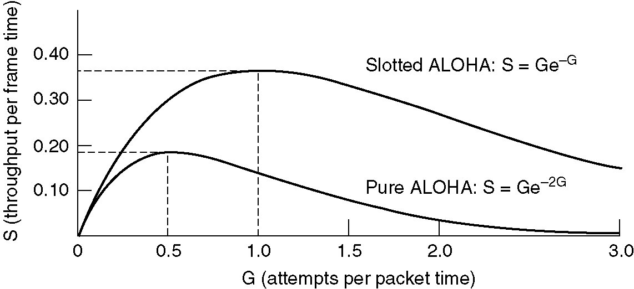
Slotted ALOHA: Throughput
The maximum throughput occurs at G=1
Why?
S=1/e which is around 0.368 → Twice that of Pure ALOHA

Slide 39
Slotted ALOHA: Throughput
BEST: If G=1,
probability of an empty slot is 0.368
37% of slots empty, 37% success, 26% collisions
If G increases:
number of empty slots decreases
number of collisions increases (exponentially!!)

Slide 40
Slotted ALOHA: Throughput
If G increases:
consider a test frame (given that a frame is generated):
Pr[success]=e^{-G}
Pr[success at exactly k attempts]=P_{k}=e^{-G} (1-e^{-G})^{k-1}
Expected number of transmissions per generated frame
Small increase in channel
load G can drastically
reduce the performance!

Slide 41
Example
Consider a slotted ALOHA system in which a frame is transmitted in k slot times. The channel load is G frames per frame time. Assuming an ∞ user population, what is the throughput, S, in units of frames per frame time? Find the throughput in the limiting cases of k=1 and k→ ∞ and interpret these cases.
Idea: Determine the vulnerable period
1
k
1
k
Vulnerable period 2k-1

Slide 42
Problems with Pure/Slotted ALOHA
Pure ALOHA
Transmit whenever a message is ready
Retransmit when there is a collision
Slotted ALOHA
Time is divided into equal time slots
Transmit only at the beginning of a time slot
Avoid partial collisions
Increase delay, and require synchronization
They do not listen to the channel !!!

Slide 43
Data Link Layer Part III: Medium Access Control

